Slide 1
The Effect of Substrate Choice on Graphene and Oxygen Plasma Interactions
Charlotte K. Johnson, ASU/NASA Space Grant
Christie J. Trimble, Anna M. Zaniewski, and Robert J. Nemanich
Department of Physics, Arizona State University

Slide 2
Project Introduction
Problem: Exposure to oxygen plasma damages graphene
Could substrate selection mitigate some of the oxygen plasma etching of graphene?

Slide 3
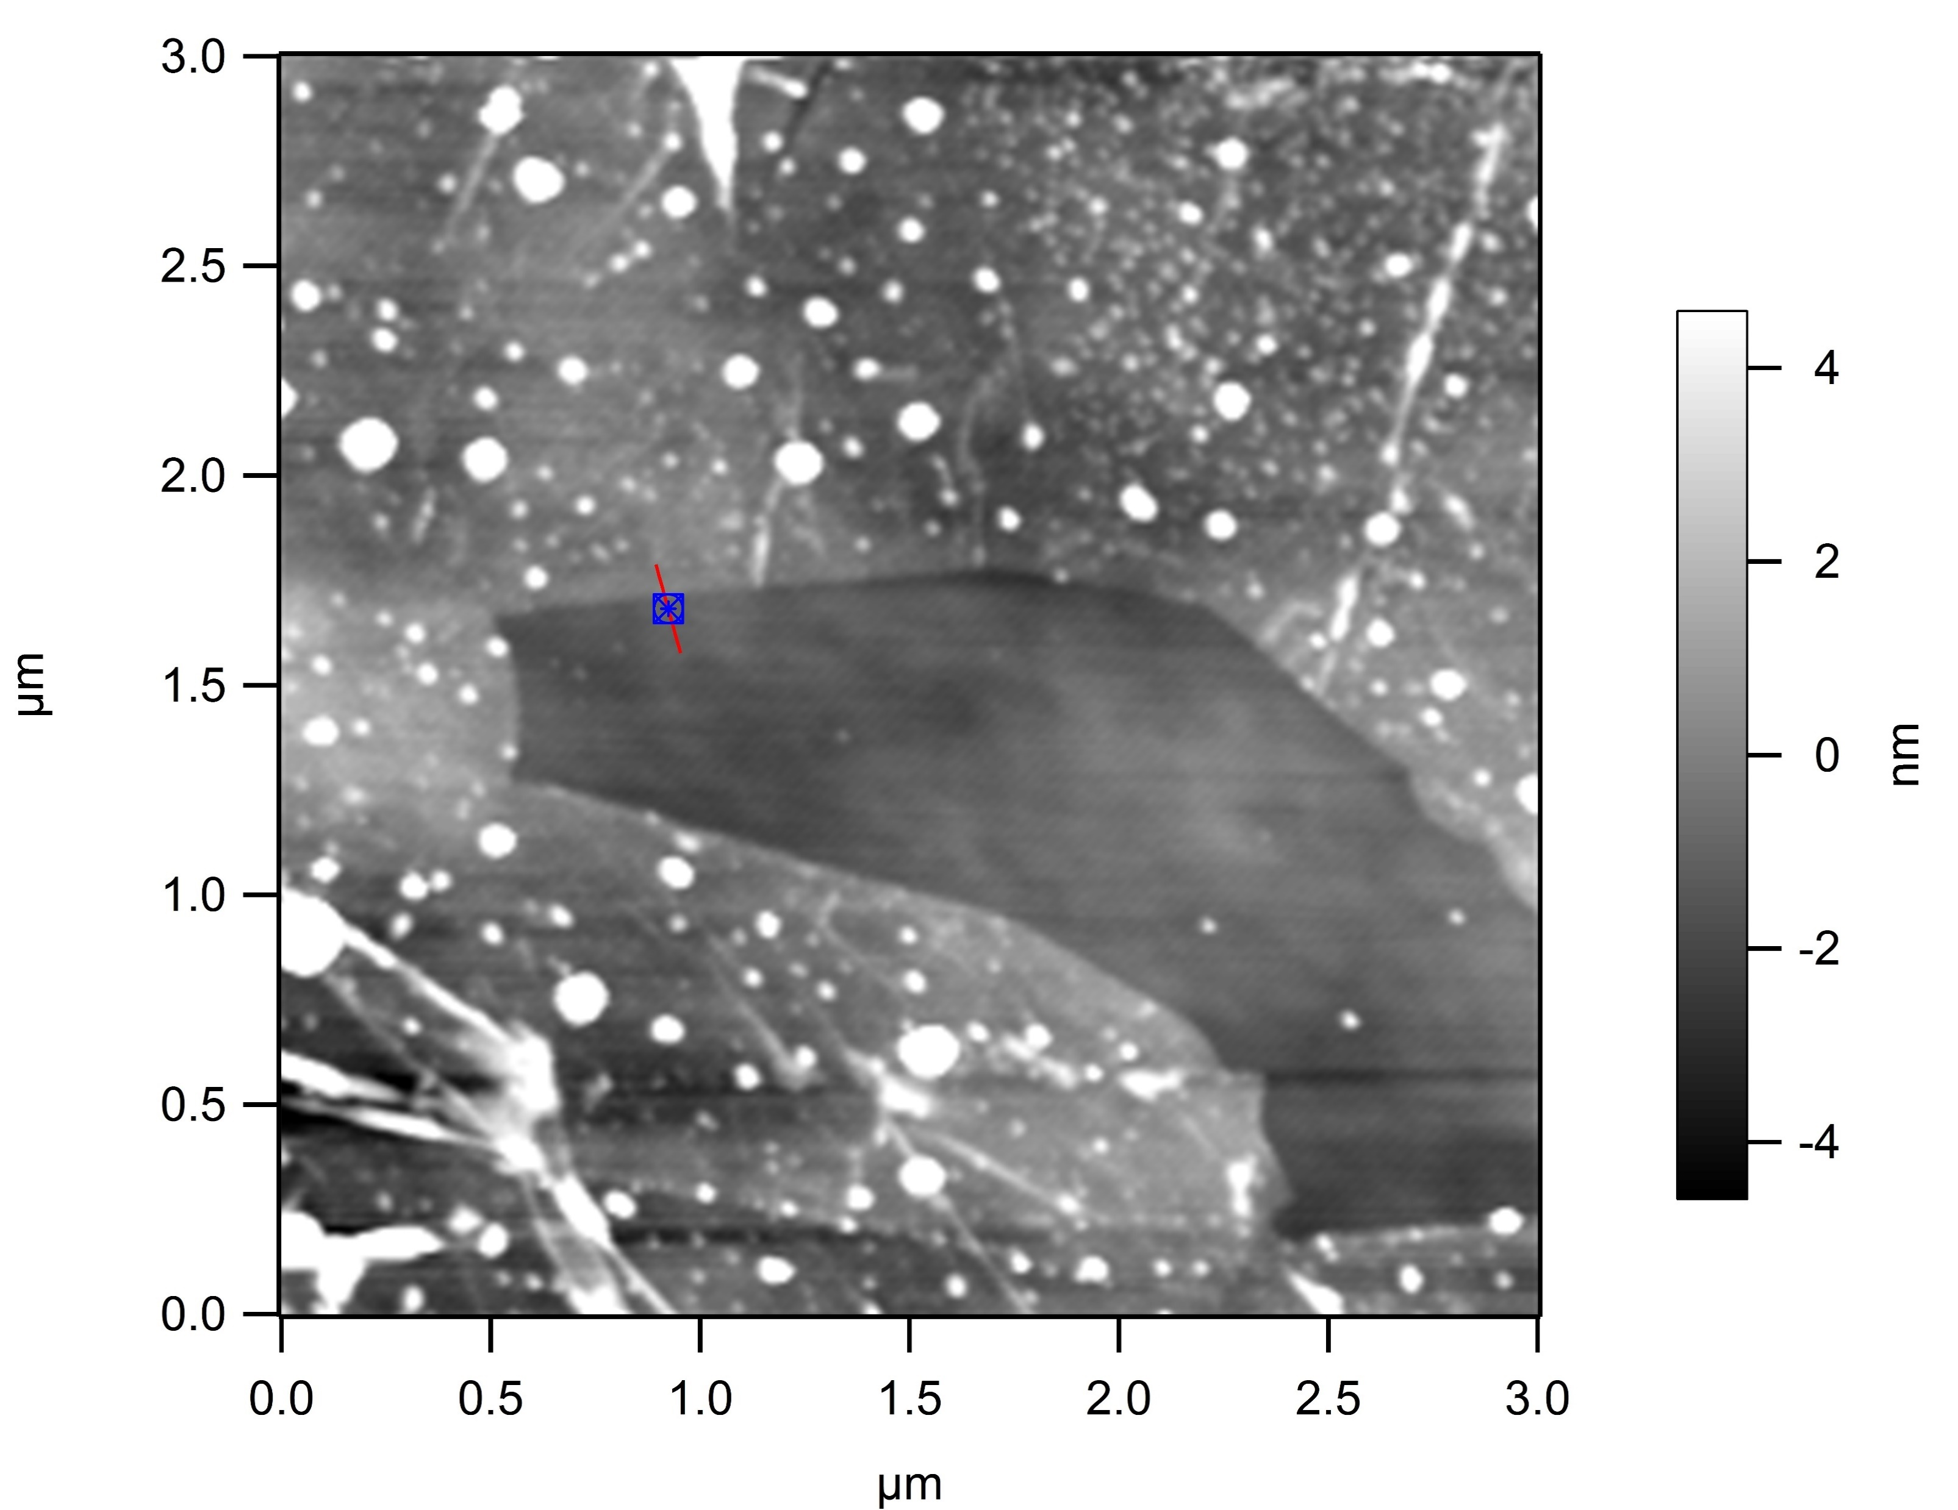
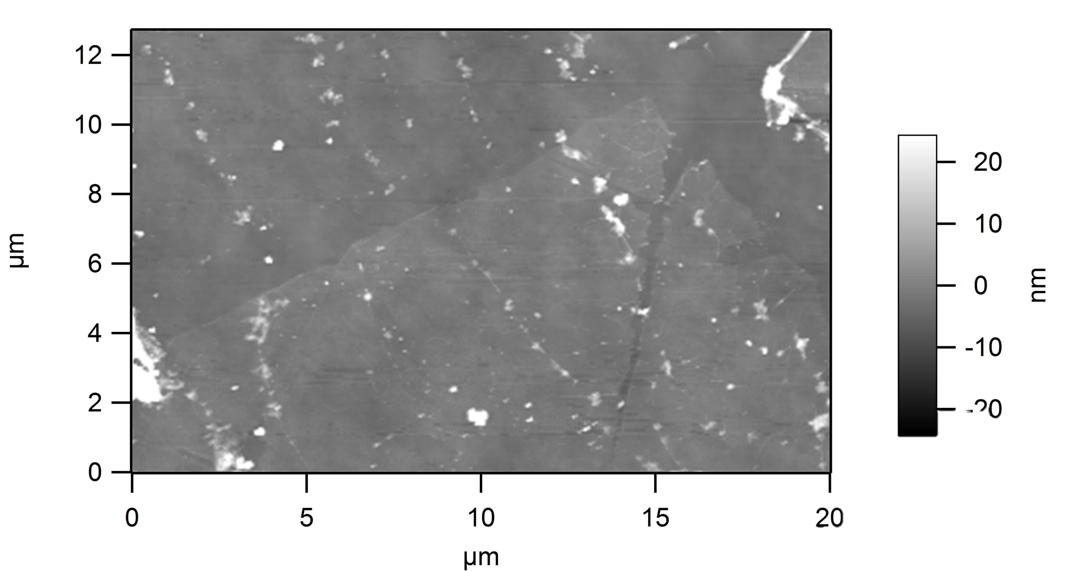
PMMA transfer method
Before hydrogen furnace treatment
After hydrogen furnace treatment

Slide 4
Raman Spectrum- Quartz substrate

Slide 5
Raman Spectrum- PPLN substrate

Slide 6
Raman Spectrum- Silicon substrate

Slide 7
Raman Spectrum- Copper substrate

Slide 8
Next Steps
Atomic Layer Deposition Chamber- plasma exposure
Raman Spectroscopy
Analysis
Notes:
To remove more of the remaining PMMA, the samples were cleaned in a small tube furnace in an atmosphere of 5% Hydrogen in Argon. This process sublimated much of the remaining PMMA particles off of the surface of the samples.

Slide 9
Thank you!
Special thanks to the ASU/NASA Space Grant Program, Dr. Anna Zaniewski, Christie Trimble, and the NSL group at ASU

Slide 10
Questions?

Slide 11

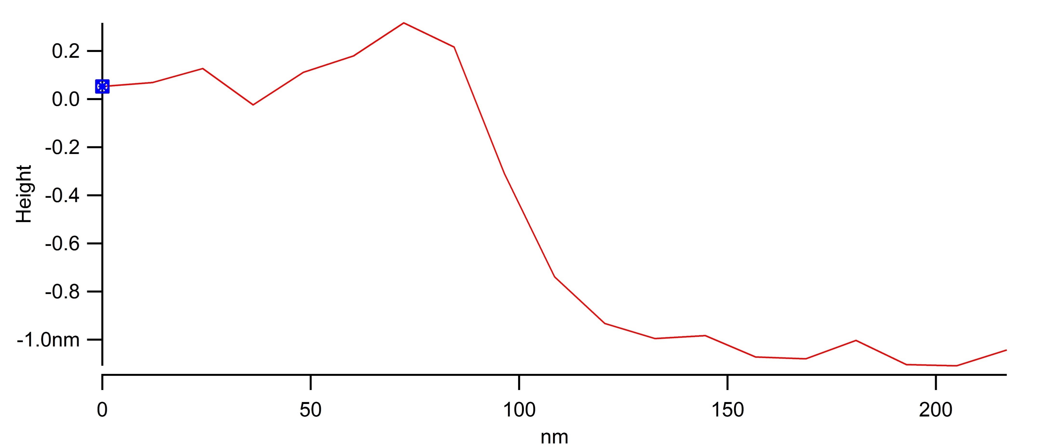
Graphene monolayer ~1 nm in height atop silicon substrate

